Slide 1
Activities and Intents
Android Developer Fundamentals V2
Lesson 2

Slide 2
2.1 Activities and Intents

Slide 3
Contents
Activities
Defining an Activity
Starting a new Activity with an Intent
Passing data between activities with extras
Navigating between activities

Slide 4
Activities
(high-level view)

Slide 5
What is an Activity?
An Activity is an application component
Represents one window, one hierarchy of views
Typically fills the screen, but can be embedded in other Activity or a appear as floating window
Java class, typically one Activity in one file

Slide 6
What does an Activity do?
Represents an activity, such as ordering groceries, sending email, or getting directions
Handles user interactions, such as button clicks, text entry, or login verification
Can start other activities in the same or other apps
Has a life cycle—is created, started, runs, is paused, resumed, stopped, and destroyed

Slide 7
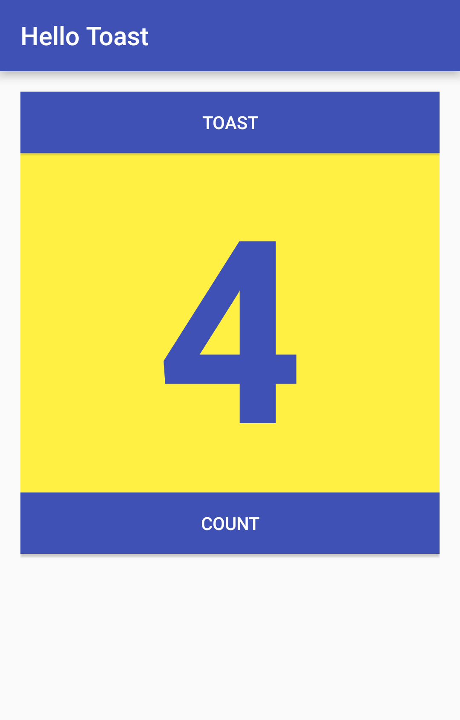
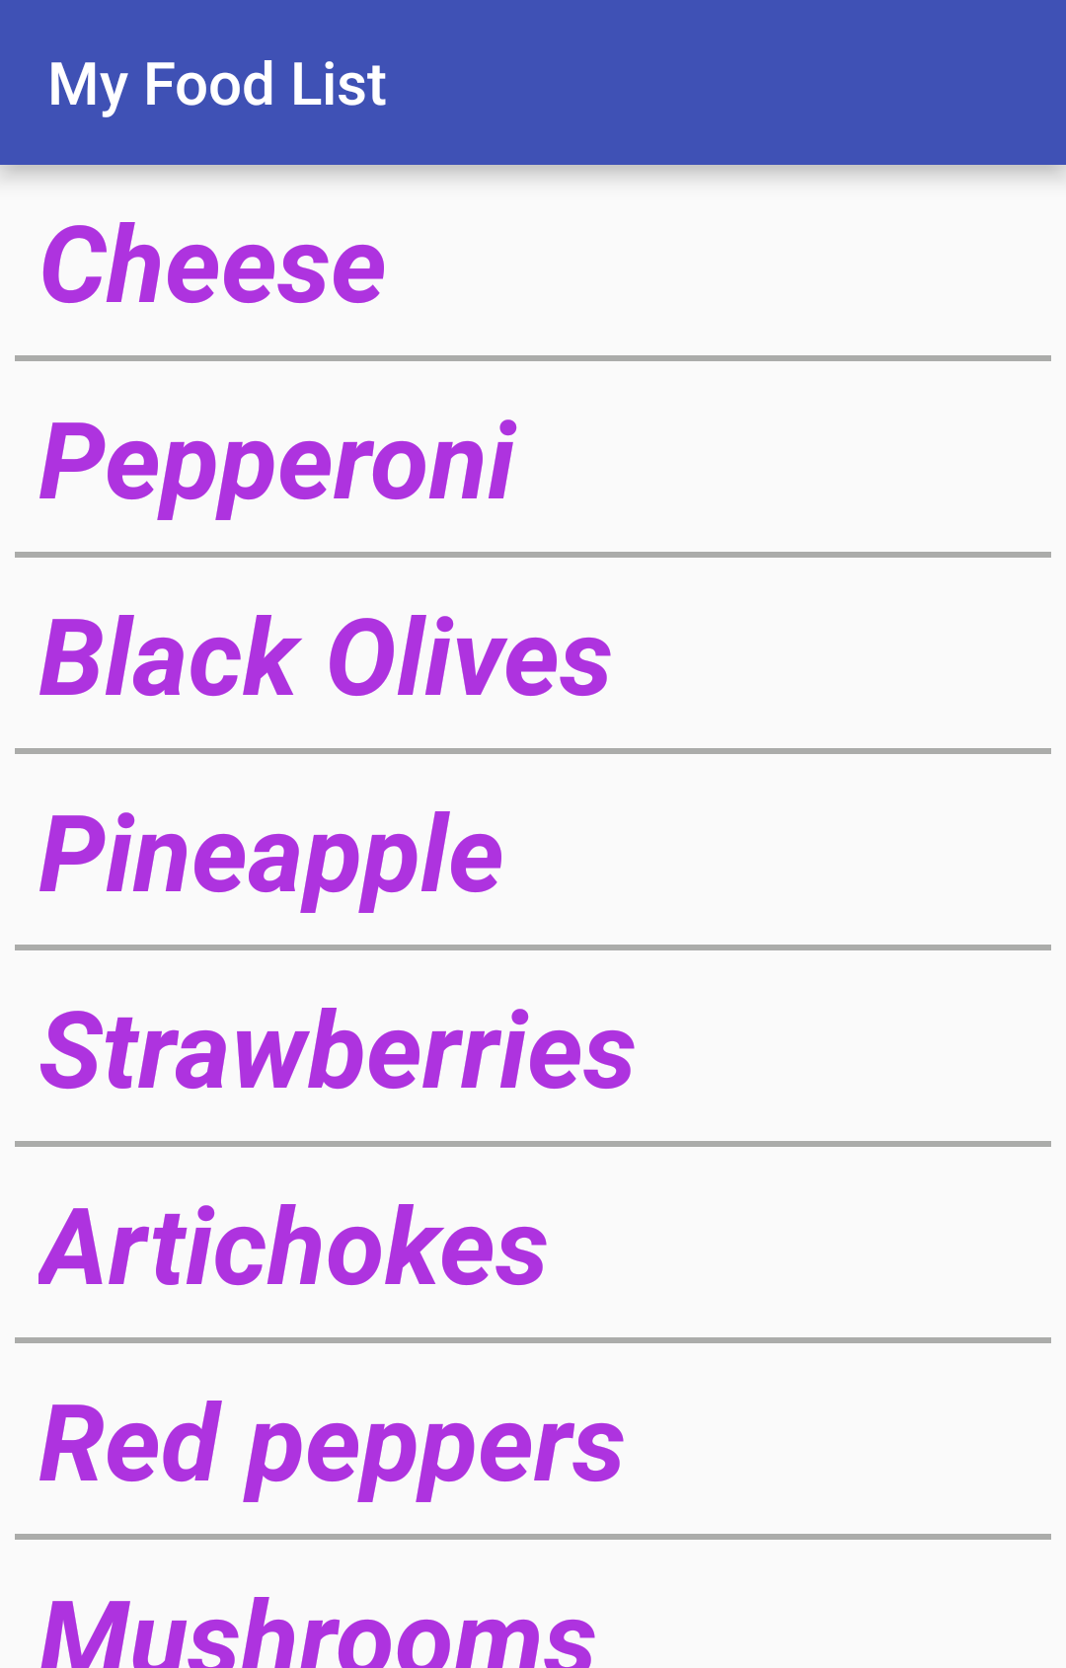
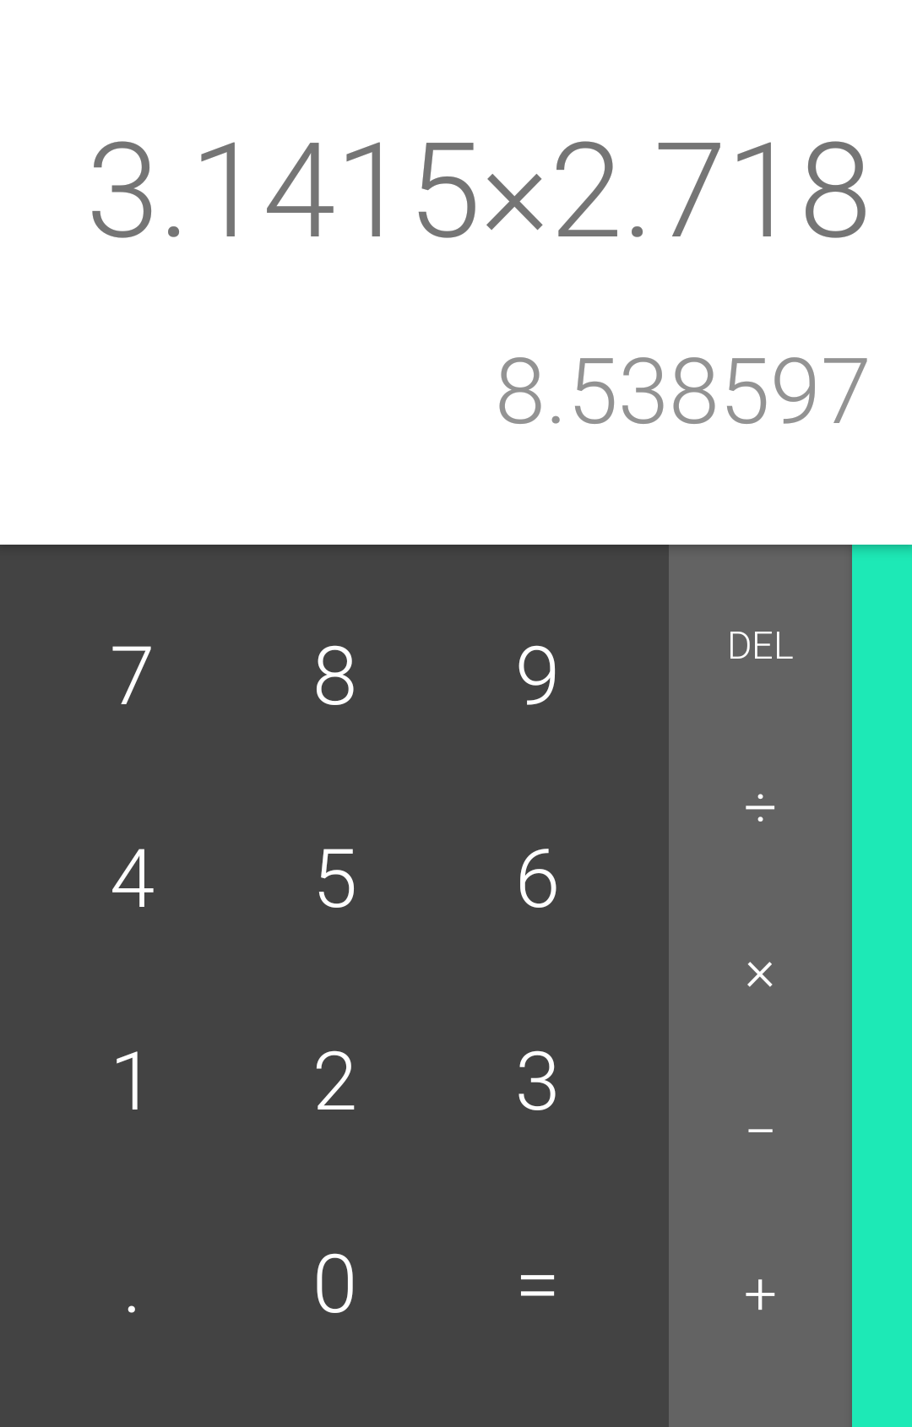
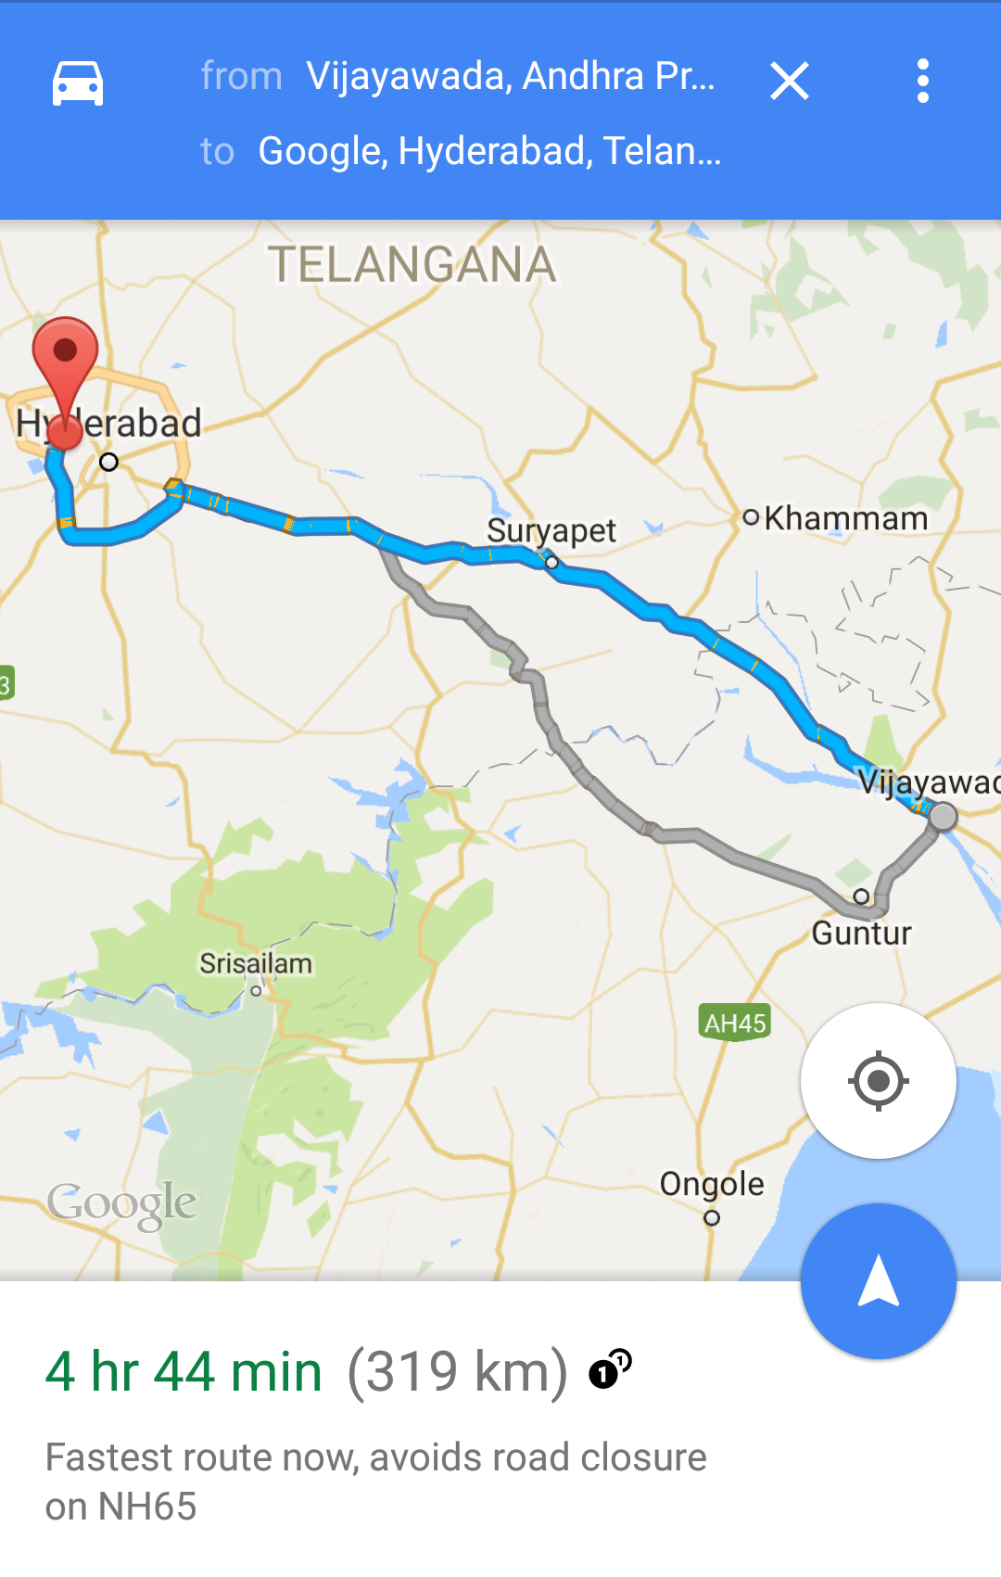
Examples of activities

Slide 8
Apps and activities
Activities are loosely tied together to make up an app
First Activity user sees is typically called "main activity"
Activities can be organized in parent-child relationships in the Android manifest to aid navigation

Slide 9
Layouts and Activities
An Activity typically has a UI layout
Layout is usually defined in one or more XML files
Activity "inflates" layout as part of being created

Slide 10
Implementing Activities

Slide 11
Implement new activities
Define layout in XML
Define Activity Java class
extends AppCompatActivity
Connect Activity with Layout
Set content view in onCreate()
Declare Activity in the Android manifest

Slide 12
Define layout in XML
<?xml version="1.0" encoding="utf-8"?>
<RelativeLayout
xmlns:android="http://schemas.android.com/apk/res/android"
android:layout_width="match_parent"
android:layout_height="match_parent">
<TextView
android:layout_width="wrap_content"
android:layout_height="wrap_content"
android:text="Let's Shop for Food!" />
</RelativeLayout>

Slide 13
2. Define Activity Java class
public class MainActivity extends AppCompatActivity {
@Override
protected void onCreate(Bundle savedInstanceState) {
super.onCreate(savedInstanceState);
}
}

Slide 14
3. Connect activity with layout
public class MainActivity extends AppCompatActivity {
@Override
protected void onCreate(Bundle savedInstanceState) {
super.onCreate(savedInstanceState);
setContentView(R.layout.activity_main);
}
}
Resource
is layout
in this XML file

Slide 15
4. Declare activity in Android manifest
<activity android:name=".MainActivity">

Slide 16
4. Declare main activity in manifest
MainActivity needs to include intent-filter to start from launcher
<activity android:name=".MainActivity">
<intent-filter>
<action android:name="android.intent.action.MAIN" />
<category android:name="android.intent.category.LAUNCHER" />
</intent-filter>
</activity>

Slide 17
Intents

Slide 18
What is an intent?
An Intent is a description of an operation to be performed.
An Intent is an object used to request an action from another app component via the Android system.
Originator
App component
Intent
Action
Android System

Slide 19
What can intents do?
Start an Activity
A button click starts a new Activity for text entry
Clicking Share opens an app that allows you to post a photo
Start an Service
Initiate downloading a file in the background
Deliver Broadcast
The system informs everybody that the phone is now charging

Slide 20
Explicit and implicit intents
Explicit Intent
Starts a specific Activity
Request tea with milk delivered by Nikita
Main activity starts the ViewShoppingCart Activity
Implicit Intent
Asks system to find an Activity that can handle this request
Find an open store that sells green tea
Clicking Share opens a chooser with a list of apps

Slide 21
Starting Activities

Slide 22
Start an Activity with an explicit intent
To start a specific Activity, use an explicit Intent
Create an Intent
Intent intent = new Intent(this, ActivityName.class);
Use the Intent to start the Activity
startActivity(intent);

Slide 23
Start an Activity with implicit intent
To ask Android to find an Activity to handle your request, use an implicit Intent
Create an Intent
Intent intent = new Intent(action, uri);
Use the Intent to start the Activity
startActivity(intent);

Slide 24
Implicit Intents - Examples
Show a web page Uri uri = Uri.parse("http://www.google.com"); Intent it = new Intent(Intent.ACTION_VIEW,uri); startActivity(it);
Dial a phone number Uri uri = Uri.parse("tel:8005551234");
Intent it = new Intent(Intent.ACTION_DIAL, uri);
startActivity(it);

Slide 25
How Activities Run
All Activity instances are managed by the Android runtime
Started by an "Intent", a message to the Android runtime to run an activity
User clicks launcher icon
MainActivity What do you want to do?
FoodListActivity Choose food items...Next
OrderActivity Place order
Intent: Start app
Start main activity
Intent: Shop
Start choose food activity
Intent: order
Start finish order activity
Android System
Android System
Android System

Slide 26
Sending and Receiving Data

Slide 27
Two types of sending data with intents
Data—one piece of information whose data location can be represented by an URI
Extras—one or more pieces of information as a collection of key-value pairs in a Bundle

Slide 28
Sending and retrieving data
In the first (sending) Activity:
Create the Intent object
Put data or extras into that Intent
Start the new Activity with startActivity()
In the second (receiving) Activity:
Get the Intent object, the Activity was started with
Retrieve the data or extras from the Intent object

Slide 29
Putting a URI as intent data
// A web page URL
intent.setData(
Uri.parse("http://www.google.com"));
// a Sample file URI
intent.setData(
Uri.fromFile(new File("/sdcard/sample.jpg")));

Slide 30
Put information into intent extras
putExtra(String name, int value) ⇒ intent.putExtra("level", 406);
putExtra(String name, String[] value) ⇒ String[] foodList = {"Rice", "Beans", "Fruit"}; intent.putExtra("food", foodList);
putExtras(bundle); ⇒ if lots of data, first create a bundle and pass the bundle.
See documentation for all

Slide 31
Sending data to an activity with extras
public static final String EXTRA_MESSAGE_KEY = "com.example.android.twoactivities.extra.MESSAGE";
Intent intent = new Intent(this, SecondActivity.class);
String message = "Hello Activity!";
intent.putExtra(EXTRA_MESSAGE_KEY, message);
startActivity(intent);

Slide 32
Get data from intents
getData(); ⇒ Uri locationUri = intent.getData();
int getIntExtra (String name, int defaultValue) ⇒ int level = intent.getIntExtra("level", 0);
Bundle bundle = intent.getExtras(); ⇒ Get all the data at once as a bundle.
See documentation for all

Slide 33
Returning data to the starting activity
Use startActivityForResult() to start the second Activity
To return data from the second Activity:
Create a new Intent
Put the response data in the Intent using putExtra()
Set the result to Activity.RESULT_OK or RESULT_CANCELED, if the user cancelled out
call finish() to close the Activity
Implement onActivityResult() in first Activity

Slide 34
startActivityForResult()
startActivityForResult(intent, requestCode);
Starts Activity (intent), assigns it identifier (requestCode)
Returns data via Intent extras
When done, pop stack, return to previous Activity, and execute onActivityResult() callback to process returned data
Use requestCode to identify which Activity has "returned"

Slide 35
startActivityForResult() Example
public static final int CHOOSE_FOOD_REQUEST = 1;
Intent intent = new Intent(this, ChooseFoodItemsActivity.class);
startActivityForResult(intent, CHOOSE_FOOD_REQUEST);

Slide 36
Return data and finish second activity
// Create an intent
Intent replyIntent = new Intent();
// Put the data to return into the extra
replyIntent.putExtra(EXTRA_REPLY, reply);
// Set the activity's result to RESULT_OK
setResult(RESULT_OK, replyIntent);
// Finish the current activity
finish();

Slide 37
Implement onActivityResult()
public void onActivityResult(int requestCode,
int resultCode, Intent data) {
super.onActivityResult(requestCode, resultCode, data);
if (requestCode == TEXT_REQUEST) { // Identify activity
if (resultCode == RESULT_OK) { // Activity succeeded
String reply = data.getStringExtra(SecondActivity.EXTRA_REPLY);
// … do something with the data
}}}

Slide 38
Navigation

Slide 39
Activity stack
When a new Activity is started, the previous Activity is stopped and pushed on the Activity back stack
Last-in-first-out-stack—when the current Activity ends, or the user presses the Back button, it is popped from the stack and the previous Activity resumes

Slide 40
Activity Stack
After viewing shopping cart, user decides to add more items, then places order.
OrderActivity Place order
CartActivity View shopping cart
CartActivity View shopping cart
OrderActivity Place order
CartActivity View shopping cart
CartActivity View shopping cart
FoodListActivity Choose food items
FoodListActivity Choose food items
FoodListActivity Choose food items
FoodListActivity Choose food items
MainActivity What do you want to do?
MainActivity What do you want to do?
MainActivity What do you want to do?
MainActivity What do you want to do?

Slide 41


Two forms of navigation
Temporal or back navigation
provided by the device's Back button
controlled by the Android system's back stack
Ancestral or up navigation
provided by the Up button in app's action bar
controlled by defining parent-child relationships between activities in the Android manifest
Notes:
Up is left

Slide 42
Back navigation
Back stack preserves history of recently viewed screens
Back stack contains all the Activity instances that have been launched by the user in reverse order for the current task
Each task has its own back stack
Switching between tasks activates that task's back stack
Notes:
Up is left

Slide 43
Up navigation
Goes to parent of current Activity
Define an Activity parent in Android manifest
Set parentActivityName
<activity
android:name=".ShowDinnerActivity"
android:parentActivityName=".MainActivity" >
</activity>

Slide 44
Learn more

Slide 45
Learn more
Android Application Fundamentals
Starting Another Activity
Activity (API Guide)
Activity (API Reference)
Intents and Intent Filters (API Guide)
Intent (API Reference)
Navigation

Slide 46
What's Next?
Concept Chapter: 2.1 Activities and Intents
Practical: 2.1 Activities and intents

Slide 47
END

Slide 48
CODELABS

Slide 49
App Overview
MainActivity
Select photo button
Share photo button
ImageView to preview the selected photo
Handle Intent
MainActivity intent filter to handle action SEND
Type: image/*
Display the shared image

Slide 50
Task 1
Build the UI
Two buttons
One ImageView

Slide 51
Task 2
Declare the Intent filter in manifest file
Write code to read shared photos
Display preview

Slide 52
Task 3
Write code to open photo chooser using an implicit intent
Write code for the sharing button

